Slide 1
Wi-Fi 6E Full-Campus Upgrade Proposal
——triOS Kitchener Campus
Zhengzheng LI

Slide 2
Wi-Fi 6E Network Upgrade Proposal
triOS Kitchener Campus – Secure, Scalable, Future-Ready
01
02
03
04
05
Modernization of wireless infrastructure with Wi-Fi 6E
16 strategically placed APs for complete indoor coverage
1,000+ device support across classrooms, labs, offices, and public areas
WPA3-Enterprise, VLAN isolation, and fast roaming enabled
License-free solution with centralized local management

Slide 3
01
Legacy Wi-Fi 4 (802.11n) with limited bandwidth and range
02
Frequent dead zones in corridors and classrooms
Why Do We Need This Upgrade?
03
No support for WPA3, fast roaming, or beamforming
04
Wired PCs and legacy VoIP phones limit mobility
05
Guest users face unstable or unsecured access

Slide 4
SMART Objectives of the Project
S
M
A
R
T
Specific:
Deliver –65 dBm or better signal strength across all zones
Measurable:
Achievable：
Realistic:
Time-bound:
Support 1,000+ concurrent users with 100 Mbps each
Use existing infrastructure for fast install
Budget under $13,000
Complete deployment in 4 weeks

Slide 5
Site Conditions and RF Constraints
01
02
03
04
05
Thick concrete walls (≥ 20 dB loss) between rooms
Metal cubicles in Testing Centre affect signal propagation
Ceiling grid available for unobtrusive AP mounting
Guest areas near glass walls require signal containment
IDFs and PoE+ switches already installed in strategic zones

Slide 6
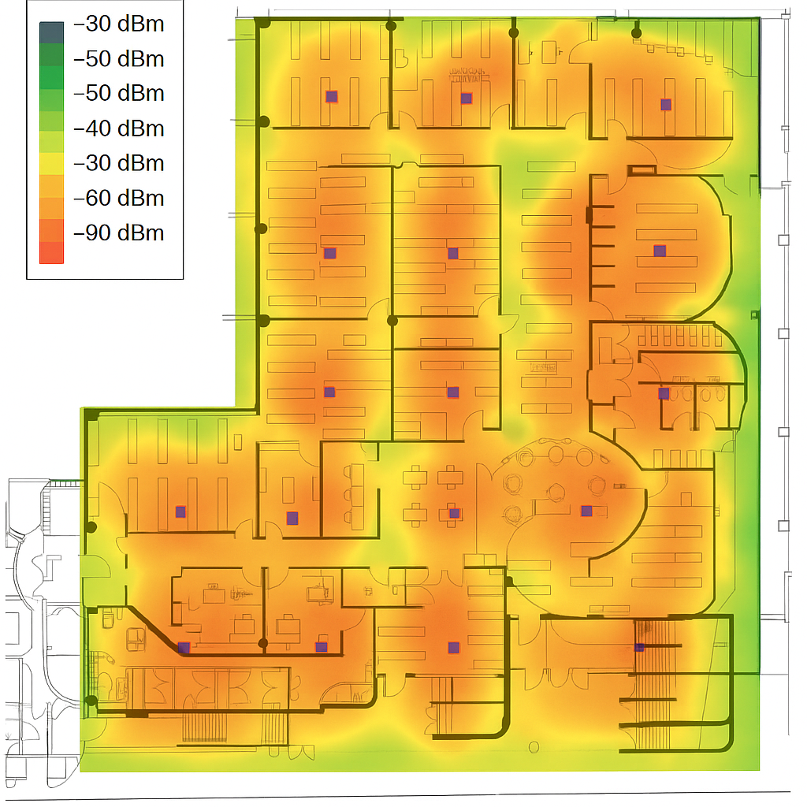
Access Point Placement – 16 Total
2 APs in North Corridor: serve Rooms 132–138
2 APs in South Corridor: Rooms 140–147
1 AP each in Room 9 and Room 15 (laptop-heavy)
2 APs in Office Area: directional units for north/south ends
2 APs for Testing Centre and Lab (patch + shared coverage)
1 Guest AP covering Commons and Waiting Area (capped power)
1 Redundant AP in IDF (mesh standby for failover)
5 remaining APs for conference zones and roaming stability

Slide 7

How We Meet Step 2 Requirements
802.11r/k/v enabled for seamless roaming
Classroom PCs migrate to WLAN;
VoIP → VoWi-Fi
01
04
Staff & students: WPA3-Enterprise + RADIUS authentication
AP power capped in public zones to prevent RF leakage
02
05
WIDS monitors rogue APs and signal leakage
Guests: TRIOS-Guest SSID with captive portal + ACL isolation
03
06

Slide 8

Vendor Comparison Summary
Feature | Cisco Catalyst 9136 | Aruba AP-635 | Ubiquiti U6 Enterprise
License-Free? | ❌ | ❌ | ✅
8x8 MIMO | ✅ | ✅ | ❌
Cloud Lock-In | ✅ | ✅ | ❌
WPA3 & VLANs | ✅ | ✅ | ✅
Full 6 GHz Support | ✅ | ✅ | ✅
TCO (5-Year, 16 APs) | > CA$24,000 | ~CA$19,000 | ~CA$8,000

Slide 9
Why Choose Ubiquiti?
01
05
02
Tri-band 6E APs with MU-MIMO and beamforming
WPA3-Enterprise, RADIUS, VLANs, roaming support
On-prem UniFi Controller (Docker or Cloud Key)
04
03
Easy monitoring with heatmaps, alerts, and logs
No annual fees, no vendor lock-in, fast deployment

Slide 10
Budget and Timeline
Item | Cost (CAD)
16 × U6 Enterprise | 8,000
2 × PoE+ Switches | 1,090
Cabling + brackets | 1,800
Installation labor | 1,200
RF film (glass) | 800
Total | 12,890
Week | Activities | Deliverables
1 | Hardware purchase; Controller setup | BOM receipt; Controller online
2 | Night-time Cat6A runs | Cable test report
3 | AP install; VLAN + SSID config | Heatmap ≥ –65 dBm
4 | UAT; VoWi-Fi testing; training | Final sign-off pack

Slide 11
Conclusion
Full campus Wi-Fi coverage with –65 dBm minimum
Fast roaming, guest segmentation, no license costs
WPA3-secure access for students, staff, and BYOD
Redundant failover, future-proof design

Slide 12
Thank you
Zhengzheng LI

